Slide 1
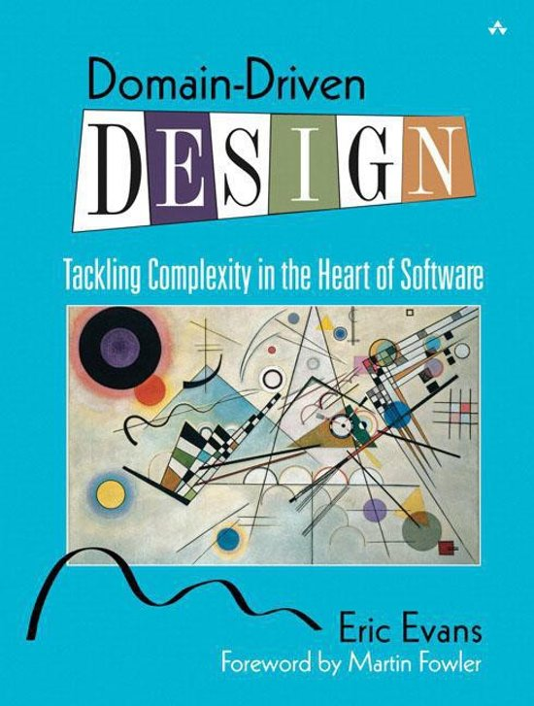
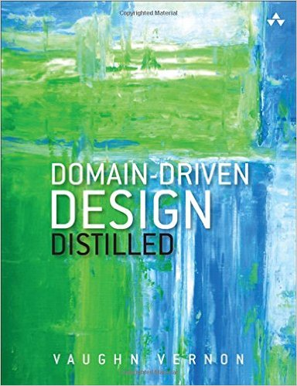
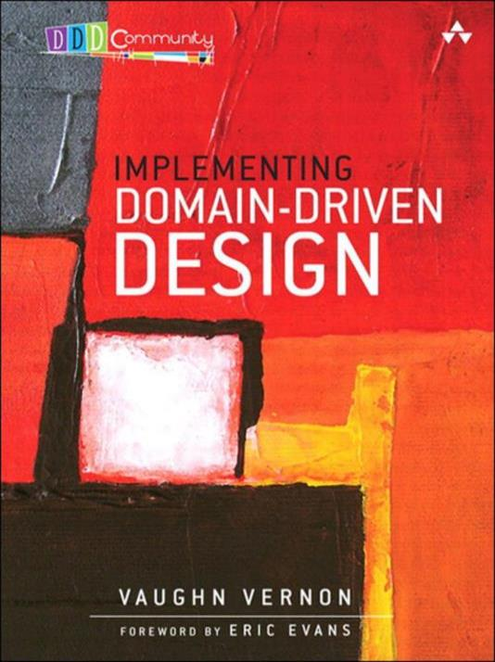
Domain Driven
Design
Strategic design & Microservices
http://radblog.pl/DDD

Slide 2

WHY
SHOULD
YOU
EVEN
CARE?

Slide 3


Radek Maziarka
objectivity.co.uk
radblog.pl
@RadekMaziarka

Slide 4
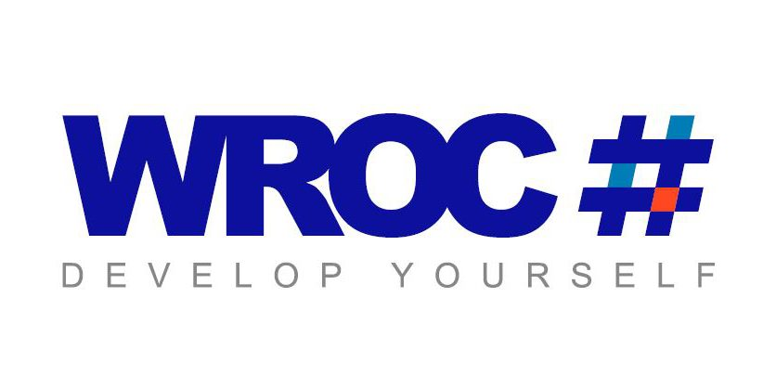
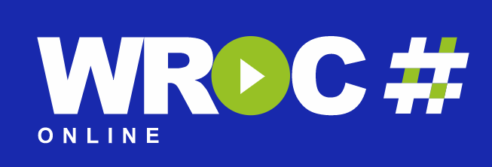

Slide 5

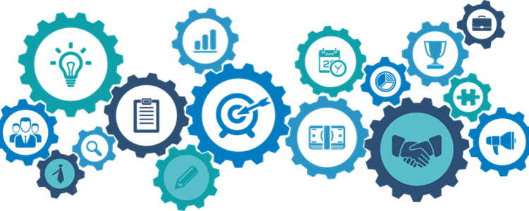
Monolith
Microservices

Slide 6
Modularity – the final frontier
Łukasz Szydło at Boiling Frogs 2018
DISTRIBUTED
 | NO | YES
NO | Monolith
YES |  | Microservices
Distributed Monolith
MODULAR

Slide 7
Ecommerce platform
Multiple areas in selling products
STORE
ORDERS
DELIVERY
PRODUCT MANAGEMENT
ACCOUNTS
NOTIFICATIONS

Slide 8
Splitting Monolith by distribution
Most common transition to microservices
App
Service 1
Service 2
Account
Func 1
Delivery
Func 1
Account
Func 3
Store
Func 1
Store
Func 2
Store
Func 1
3-Func DB
Store
Func 2
3-Func DB
Order
Func 2
Delivery
Func 1
Account
Func 2
Account
Func 3
Order
Func 2
All Func in one DB
Service 3
Service 4
Delivery
Func 3
Delivery
Func 2
Order
Func 3
Account
Func 1
Delivery
Func 3
Store
Func 3
Account
Func 2
Order
Func 3
Store
Func 3
Order
Func 1
2-Func DB
Delivery
Func 2
2-Func DB
Order
Func 1

Slide 9
Monolith splitted by distribution
Microservices fitness check
Service 1
Service 2
Account
Func 1
Delivery
Func 1
Account
Func 3
Store
Func 1
1
TRANSACTION INSIDE SERVICE
V2
V2
3-Func DB
Store
Func 2
3-Func DB
Order
Func 2
2
SINGLE DATA OWNERSHIP
Func mix in one DB
Service 3
Service 4
3
Delivery
Func 3
Store
Func 3
Account
Func 2
Order
Func 3
BUSINESS FOCUSED SERVICES
V2
2-Func DB
Delivery
Func 2
2-Func DB
Order
Func 1
4
INDEPENDENT DEPLOYMENTS
Notes:
- Being closely aligned to business DDD results in better mapping client’s needs to product.
- DDD focuces on creating common understanding between project’s parties.
- DDD strategies allows to create more modular and maintable application.

Slide 10
Distributed Monolith
Disadvantages of distributed big ball of mud
Service 1
Service 2
Account
Func 1
Delivery
Func 1
Account
Func 3
Store
Func 1
1
DISTRIBUTED TRANSACTION
3-Func DB
Store
Func 2
3-Func DB
Order
Func 2
2
NO DATA OWNERSHIP
Service 3
Service 4
3
Delivery
Func 3
Store
Func 3
Account
Func 2
Order
Func 3
MIXED SERVICES
2-Func DB
Delivery
Func 2
2-Func DB
Order
Func 1
4
DEPENDENT DEPLOYMENTS
Notes:
- Being closely aligned to business DDD results in better mapping client’s needs to product.
- DDD focuces on creating common understanding between project’s parties.
- DDD strategies allows to create more modular and maintable application.

Slide 11
Distributed Monolith - articles
Why you should not take this step

Slide 12

MICROSERVICES ARE
TECHNICAL SOLUTION
And developers love technical solutions
JAKUB NABRDALIK
Mentor in Bottega IT Solution
Conway’s revenge - Bydgoszcz JUG - https://www.youtube.com/watch?v=UhIIpUQ-i38

Slide 13
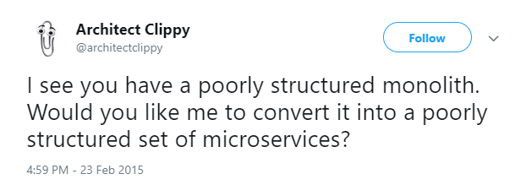
Notes:
- Being closely aligned to business DDD results in better mapping client’s needs to product.
- DDD focuces on creating common understanding between project’s parties.
- DDD strategies allows to create more modular and maintable application.

Slide 14
Modularity – the final frontier
Łukasz Szydło at Boiling Frogs 2018
DISTRIBUTED
 | NO | YES
NO | Monolith
YES |  | Microservices
Distributed Monolith
DDD
MODULAR
Modular Monolith

Slide 15
Domain Driven Design
Strategic design
Tactical patterns
Ubiquitous Language
Domain
Entities
Events
Sub-domain
Repositories
Core domain
Aggregates
Domain model
Dependency Injection
Bounded Context
Layers
Context
Factories
Services
Context Map
Generic Subdomain
Modules

Slide 16
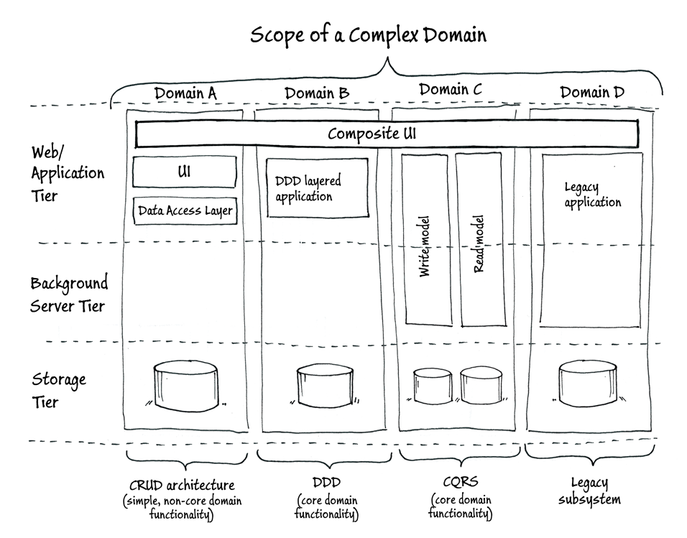
The DDD paradox
By Emilien Pecoulhas
DDD is an approach that even helps you determine when you don’t need it
Strategical Design will drive using Tactical Patterns.
https://msdn.microsoft.com/en-us/library/jj591560.aspx

Slide 17
Domain Driven Design
In ecommerce domain

Slide 18

UBIQUITOUS
LANGUAGE

Slide 19
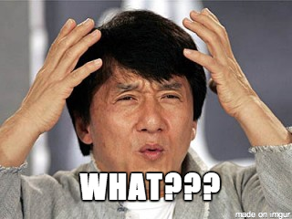
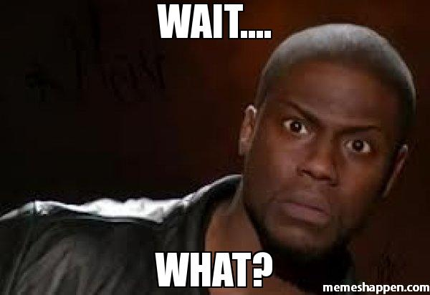
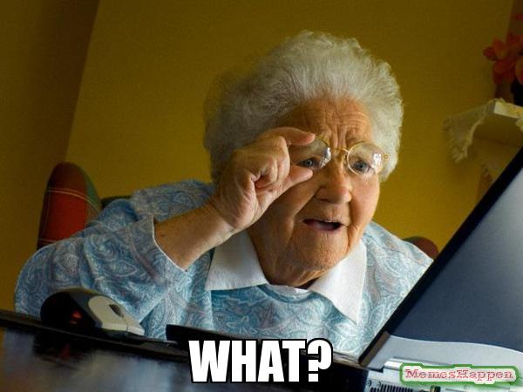
Customer stories
Client actions in a store
1
ADD ORDER
2
DELETE ORDER
3
UPDATE SHIPPING
4
ITEMS COLLECTION

Slide 20
Shared understanding
Common language between people
1
SPOKEN LANGUAGE MUST REFER TO BUSINESS
User
Client
Add order
Place order
2
SHARED LANGUAGE FROM BUSINESS
TO CODEBASE
Update delivery
Change delivery date
Items collection
Product catalogue
3
LANGUAGE WILL EVOLVE WITH
UNDERSTANDING DOMAIN
Fast shipping
Express delivery

Slide 21

Ubiquitous Language
Benefits of using UL
Deeper understanding
of business
Code adjusted
to business needs
Better cooperation
with the client

Slide 22

BOUNDED CONTEXT

Slide 23
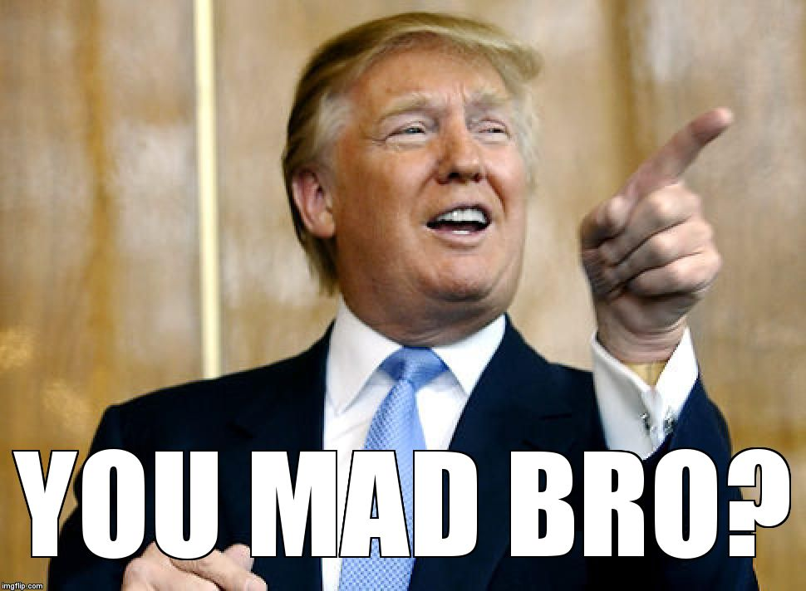
Shipping
In online store platform
1
CRUCIAL CONTEXT
2
GENERATE A LOT OF MONEY
3
CLIENT WILL FOCUS ON IT

Slide 24
Different importance
Domains are not equally significant
Store
1
CORE DOMAINS
2
SUPPORTING SUBDOMAINS
Orders
Account
Delivery
3
GENERIC SUBDOMAINS
Notifications

Slide 25
User in ecommerce context
Different meanings of users
STORE
ORDERS
DELIVERY
ACCOUNTS
Shopper who looks for a products
Can add products to basket
Customer who bought placed order
Can change payment
Recipient who gets delivery
Can change change delivery address
User in store account
Can check personal data

Slide 26
Bounded context
Things has different meaning between contexts
Orders
Delivery
1
LOGICAL BOUNDARY BETWEEN UNDERSTANDINGS
Products
Address
2
DIFFERENT MODEL FUNCTIONS
AND DATA STRUCTURE
Order
Customer
Recipient
Delivery
Payment
Company
3
UNIFIED MODEL DOES NOT EXISTS
Notes:
-
- Każdy dział będzie
- Nie da się stworzyc jednorodnego modelu ponieważ rzeczywistość nie jest jednorodna.

Slide 27
Bounded Context
Benefits of using BC
Modules divided from
business perspective
Solution adjusted
to use-case
Team bounded
to single context

Slide 28

CONTEXT MAP

Slide 29
Context map
Store
Approaches of communications between contexts
Up
1
DIFFERENT WAYS OF INTEGRATIONS
Down
Legacy Reporting
Layer
Separate Ways
Orders
Partnership
Shipping
2
TRANSLATIONS BETWEEN CONTEXT
Shared Kernel
Shared Kernel
3
SEPARATE WAYS AS INTEGRATION APPROACH
Notifications

Slide 30
Context Map
Benefits of using CM
More effective integration
between contexts
Better informed
decisions
Organized, business
architecture

Slide 31
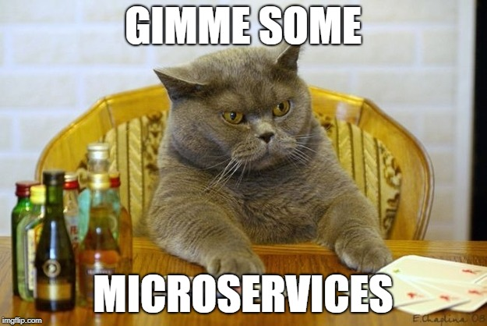

Slide 32
Monolith -> Modular Monolith
Less common transition to microservices
App
Store Module
Account Module
App
Store Func 1
Store Func 3
Account
Func 3
Account
Func 1
Store
Func 2
Store
Func 1
Store
Func 2
Account
Func 2
Delivery
Func 1
Account
Func 2
Account
Func 3
Order
Func 2
All Func in one DB
Modules inside DB
Delivery Module
Order Module
Delivery
Func 3
Delivery
Func 2
Order
Func 3
Account
Func 2
Delivery
Func 3
Order
Func 3
Store
Func 3
Order
Func 1
Delivery
Func 3
Delivery
Func 2
Account
Func 2
Order
Func 1

Slide 33
Modular Monolith -> Microservices
Transition to microservices step by step
App 1
App
Store Module
Account Module
Store Service
Account Module
Store Func 1
Store Func 3
Account
Func 3
Account
Func 1
Store Func 1
Store Func 3
Account
Func 3
Account
Func 1
Store
Func 2
Account
Func 2
Store
Func 2
Store DB
Account
Func 2
Modules inside DB
Modules inside DB
Delivery Module
Order Module
Delivery Service
Order Module
Delivery
Func 3
Order
Func 3
Delivery
Func 3
Delivery DB
Order
Func 3
Delivery
Func 3
Delivery
Func 2
Account
Func 2
Order
Func 1
Delivery
Func 3
Delivery
Func 2
Account
Func 2
Order
Func 1

Slide 34
Monolith splitted by modularization
Microservices fitness check
Store Service
Account Service
1
Store Func 1
Store Func 3
Account
Func 3
Account
Func 1
TRANSACTION INSIDE SERVICE
Store
Func 2
Store DB
Account DB
Account
Func 2
2
SINGLE DATA OWNERSHIP
Delivery Service
Order Service
3
BUSINESS FOCUSED SERVICES
Delivery
Func 3
Delivery DB
Order DB
Order
Func 3
4
Delivery
Func 3
Delivery
Func 2
Account
Func 2
Order
Func 1
INDEPENDENT DEPLOYMENTS

Slide 35

DDD
Microservices

Slide 36
radblog.pl/DDD
Articles:
Weronika Łabaj - DDD Ultra-Lite
Herberto Graca - Domain-Driven Design
Carbon Five - Ubiquitous Language & the joy of naming
Sapiens Work - DDD - The Bounded Context Explained
Philip Brown - Strategies for Integrating Bounded Contexts
Sebastian Gębski - The awesomeness of Modular Monolith
Microsoft - Tackling Business Complexity in a Microservice with DDD and CQRS Patterns
Berke Sokhan - Domain Driven Design for Services Architecture
Videos:
DevTalk - DDD with Sławomir Sobótka
DevTalk Trio - DDD
Domain Driven Design: The Good Parts - Jimmy Bogard
What is Domain Driven Design?
DDD & Microservices: At Last, Some Boundaries!
7 Reasons Why DDD Projects Fail
Books:
Eric Evans - Domain Driven Design
Vernon Vaughn - Implementing Domain-Driven Design
Vernon Vaughn - Domain-Driven Design Distilled
Sam Newman - Building Microservices: Designing Fine-Grained Systems

Slide 37
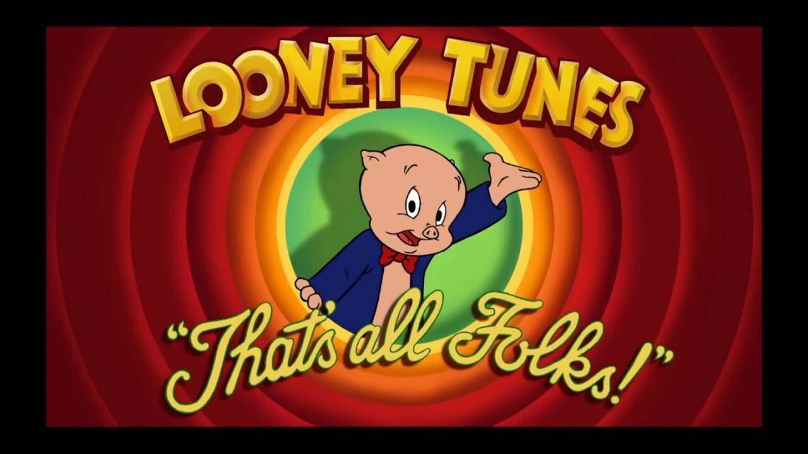
radblog.pl/DDD
radblog.pl/DDD-form

